Slide 1
About MedTech Europe
Chris Breyel
Director, MD Members Relations & MedTech Europe Events

Slide 2

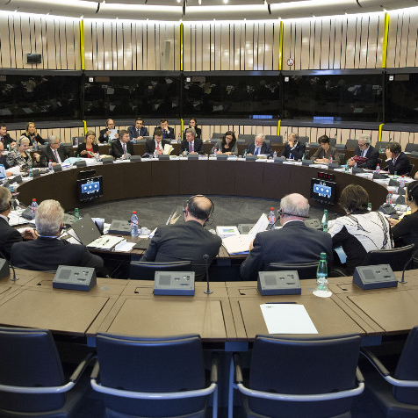
Why a European Trade Association?
The rules of the game are changing
Increasingly, policy-makers are staying ahead of the industry
What to do to stay engaged?
  More frequent exchange of views and updates on key policy dossiers are vital
  Early warning on evolving crises
  Coordinate messages and timing on advocacy on key issues

Slide 3
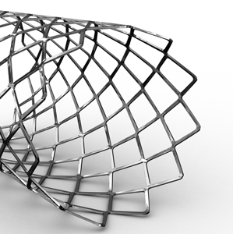
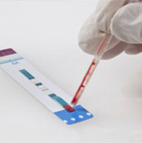
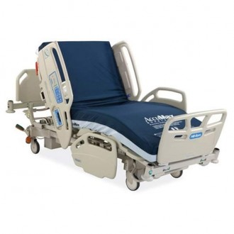
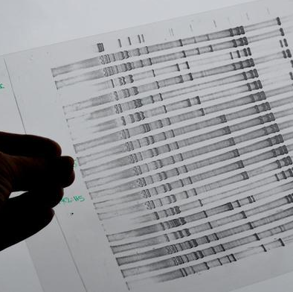
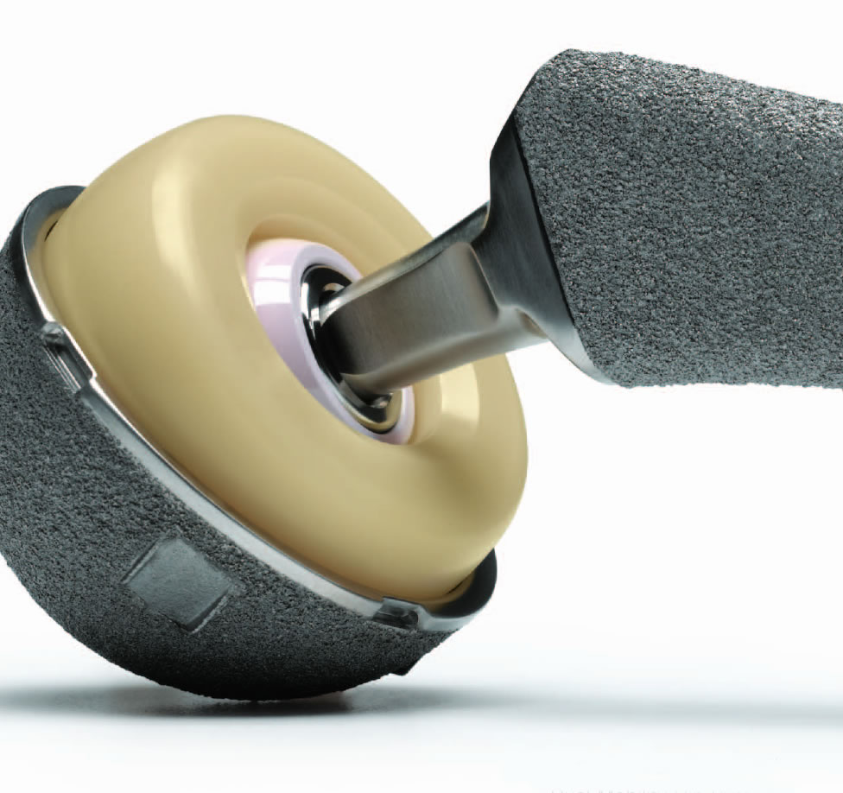
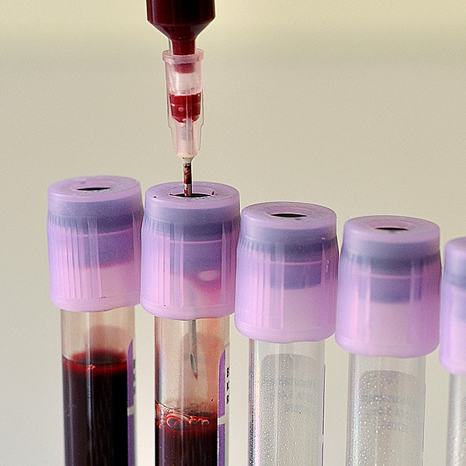
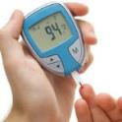


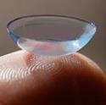

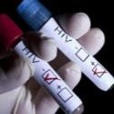
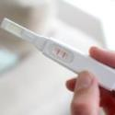


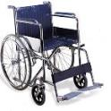


MEDICAL TECHNOLOGY is any technology used to save and improve lives of individuals suffering from a wide range of conditions.
There are more than 500,000 products, services and solutions currently available.
Notes:
These range from bandages, blood tests, and hearing aids to cancer screening tests, pacemakers and glucose monitors. These products, services and solutions can be found in a hospital, in a community-care setting, and in a person’s home.

Slide 4
The MedTech Industry in Europe
€ 110 billion
market
50,000+
In vitro diagnostics test
500,000+medical
devices
26,000+
companies
of which
95% are
SMEs
#1
In filing patent applications. 20% more than computer industries and double the pharma industry
625,000+
employees

Slide 5

The European trade association
for medical technology industries
including medical devices, diagnostics and digital health.
OUR MEMBERS
110 + multinational
Corporations*
45+ medical technology associations
*medical devices, diagnostics and digital health

Slide 6








About MedTech Europe
Based in Brussels, Belgium with 40+ staff
Regulatory and Industrial Policies
Legal and
Compliance
Government Affairs and Public Policy
Communications and Press Relations
Environmental Policy
Market Access
and Economic
Policy
International Policy
Market Information

Slide 7
2018 Priorities
MedTech Industry
Awareness
Position
IVD / MD
Regulatory
Policies
Market Access
Policies
« Value based »
New Code
of Business Practices
New
Activities & Services
Development
Notify Bodies preparedness
IVDR / MDR – Text improvement/clarification & 2nd legislation
Industry preparedness for implementation
Environmental & Chemicals Policies
MEAT Value Based Procurement – Continued deployment
HTA – EU Legislation on HTA Cooperation (repeal)
HTA for MD & HTA for IVDs (support to National situations)
Support & follow through Corporate implementation
Support to National Associations code transposition
Advocacy to Scientific Societies and PCOs
Domains of Focus
Priorities
EU Institution and stakeholders advocacy & Communication
“Promote the Value of Medical Technologies for Patients & HC”
Brexit
AMR
Digital Health & Integrated Healthcare industry leadership
WHO Medtech Industry representation
Esther / IMI – Research support for the MedTech Industry

Slide 8
About MedTech Europe
MDR
Director, MD Members Relations & MedTech Europe Events

Slide 9
MDR | What has been the process up to now (last 8-9 years)
ROUND 1
(technical)
ROUND 2
(technical & political)
ROUND 3
(political)
EP ENVI
Position
25 Sep 2013
EP Plenary
Position
22 Oct 2013
European
Parliament
1st Reading
voted
02 April 2014
Confirmed by
new EP in
Nov 2014
‘Trilogue’
=
Negotiation meetings Parliament, Council and Commission
(June 2016)
Agreement in
2nd Reading
=
Adoption of
Final Texts
& Official Publication
(Adopted April 4 2017)
(Publication May 2017)
Amending draft Commission text
COMMISSION DRAFT proposal
(26 Sept 2012)
Amending draft Commission text
COUNCIL
Position
General Approach
Agreement
(Lux Presidency)
EPSCO meeting
Oct 5 2015
COMMISSION
Empowered to Draft & Adopt
Secondary Legislation
& Guidelines
COUNCIL
Votes
on Secondary
Legislation
IVDR and MDR Empowers Commission

Slide 10
MDR – positive outcomes from advocacy on text
Still CE Marking, still notified bodies (instead of a pharma-like system)
Major blockers to innovation in early drafts deleted or balanced
No FDA-like pre-market approval (PMA)
Rejected mandatory pre-market randomized controlled trial (RCTs)/efficacy studies
Early and voluntary expert panel consultation
Pre-market assessment for safety and intended effect retained
Commercial reprocessors held to same standard as manufacturers (reprocessing and re-use of single use devices only allowed within health institutions and where permitted by national law and subject to specific requirements)
No hazardous substance ban
Transitional provisions give flexibility to market

Slide 11
Basic Regulatory Process Maintained
Product design
Conformity assessment
CE Marking
Evidence
Registration
Vigilance & Post Market
Follow-up
4
Notes:
The new Regulations significantly modifiy and intensify the compliance burden for manufacturers but in essence the main features of the regulatory framework for medical devices and IVDs remain the same
The process shown on this slide – from the initial product design phase to CE-marking and post-market follow-up – is the same for both the current directive and future regulation. In fact, overall no requirement from the Directives has been dropped; the regulations have only added new requirements.

Slide 12


MDR – All has been possible thanks to NA – MTE collaboration
The final positive outcomes from advocacy can be attributed to countless meetings and exchanges with the Commission, European Parliament, the Council as well as interactions with the national authorities etc. – all thanks to the extensive collaboration, support and engagement of national associations

Slide 13
MDR | Is the Process Over? NO – Entering Round 4, lasting 5+ years!
ROUND 1
(technical)
ROUND 2
(technical & political)
ROUND 3
(political)
EP ENVI
Position
25 Sep 2013
EP Plenary
Position
22 Oct 2013
European
Parliament
1st Reading
voted
02 April 2014
Confirmed by
new EP in
Nov 2014
‘Trilogue’
=
Negotiation meetings Parliament, Council and Commission
(June 2016)
Agreement in
2nd Reading
=
Adoption of
Final Texts
& Official Publication
(Adopted April 4 2017)
(Publication May 2017)
Amending draft Commission text
COMMISSION DRAFT proposal
(26 Sept 2012)
Amending draft Commission text
COUNCIL
Position
General Approach
Agreement
(Lux Presidency)
EPSCO meeting
Oct 5 2015
COMMISSION
Empowered to Draft & Adopt
Secondary Legislation
& Guidelines
ROUND 4
(technical)
COUNCIL
Votes
on Secondary
Legislation
IVDR and MDR Empowers Commission
Notes:
The MDR and IVDR might have entered into force but the process is far from over
We are now entering what we call the round 4, i.e. the implementation phase
The implementing measures envisaged under the Regulations convey significant powers to the European Commission (significant numbers of implementing acts where the Commission has ‘more power’ in driving the work are expected to be developed, in fact the first implementing acts lying down the notified body codes have been adopted in November 2018)
With the potential dozens of implementing measures (delegated and/or implementing acts or other measures) yet to be developed and adopted in order to facilitate the essential elements of the new regulatory system, we will need to continue working together with the national associations to make the MDR a success
Considering all the changes that the Regulations introduce to the regulatory system, implementation will require pulling of resources by all stakeholders, national authorities, the Commission, notified bodies and industry

Slide 14
Secondary measures
What are these?
    Guidelines issued by MS via MDCG/CAMD
    Common Specifications (via implementing acts)
    Other implementing/delegated acts
Which are the expectations?
    Measures should represent a pragmatic solution to those parts of the Regulation which are open to interpretation
What is MTE doing?
    MTE, as a recognized stakeholder has the possibility to participate to the development and review the proposed measures prior to their finalization

Slide 15
About MedTech Europe
HTA
Director, MD Members Relations & MedTech Europe Events

Slide 16
Background
  Current cooperation on HTA via EUnetHTA. JA3 ends in 2019 and cannot be renewed.
Objectives of the Commission:
- avoid duplications of HTA across Europe
- ensure sustainability of cooperation after 2019
- ensure financial sustainability of the healthcare systems
Notes:
EU Process:
Inception Impact Assessment: range of policy options from status quo to full regulation
Data collection: survey, consultation, studies
Adoption of Proposal: 31 January 2018

Slide 17
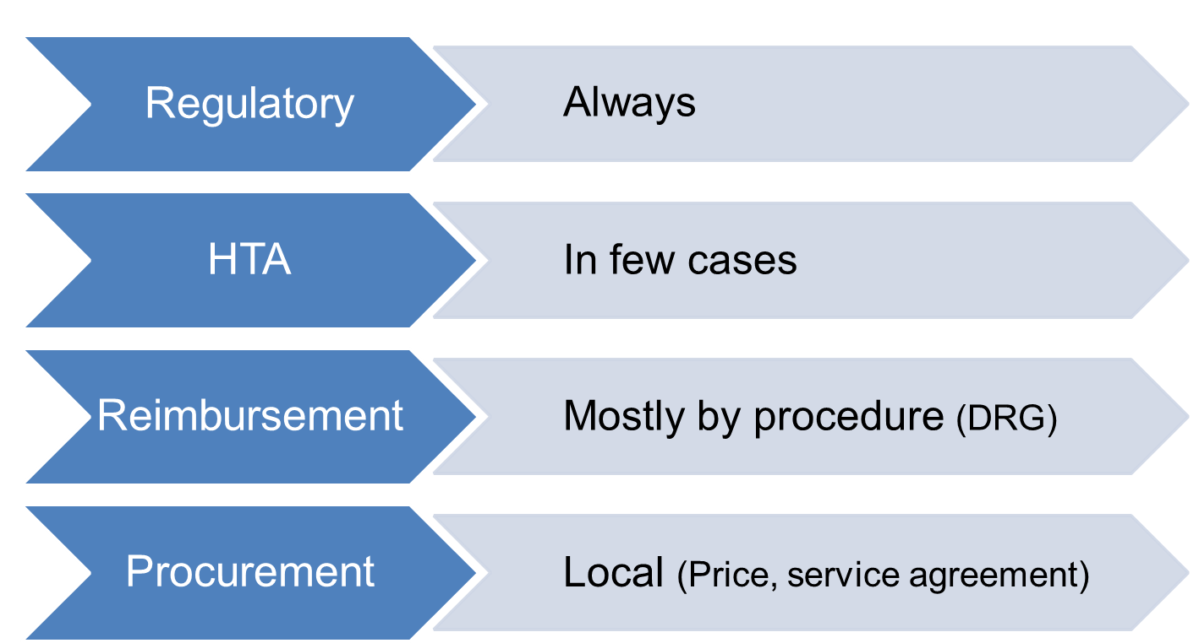
Role of HTA in Access model for medical devices
Notes:
<5 HTA assessing the same technologies within the same year, but with different purposes and different methodologies
Big confusion with Pharma System

Slide 18
EU HTA Legislative proposal – key components
1. General provisions
Regulation establishing a Coordination Group composed of HTA bodies and authorities to carry out the joint work
2. Joint work on HTA at EU level
Mandatory joint clinical assessments for selected technologies: no duplication of report by MS. Scope: high risk + comply with criteria. Not necessarily at market entry, but suspension clause for extra evidence generation
3. Rules for clinical assessments
Common rules for carrying out clinical assessments at Member State level and for joint clinical assessments. Based on EUnetHTA work?
Voluntary cooperation on other technologies (similar to current cooperation)
4. Support tools
“Joint scientific consultation” = early dialogue
The EC will act as the Secretariat for the joint work
A Stakeholder network will be established
Union funding (fee-for-service after review?)
“Identification of Emerging Health Technologies” = horizon scanning
Notes:
Governance: Strategy link is missing (as decision makers are not in the Coordination Group (only technician). No idea on Stakeholder involvement.
Heart of the text. Clinical Evaluations will be done once and for all (member states will not have the opportunity to run a new clinical assessment). High risk????!!!! Ridiculous as precisely assessed by the MDR. A lot of unpredictability
Common rules in principle we agree … but in reality we will end up with a compilation of each country methodology

Slide 19
Initial assesment of the Proposal
  Not responsive to the specific demands of Member States – decision makers.
Delays in access to beneficial innovations for patients and the transformation of healthcare systems.
Selection of technologies based on Risk and not Value (for health systems, for benefits for patients) - duplication.
Notes:
1. Risk to jeopardise the well functioning access model for medical technologies
No expected value to Europe nor Member States’ objectives (sustainability of healthsystems, access).
Extra layer of mandatory joint clinical assessment for selected technologies
Selection criteria for collaborative assessment -> continues current unpredictability, current dysfunctional cooperation
2. limitation of today’s existing range of choices of products/solutions available
pressure on SMEs no longer able to innovate due to extra financial and time resources with no reward for investment

Slide 20
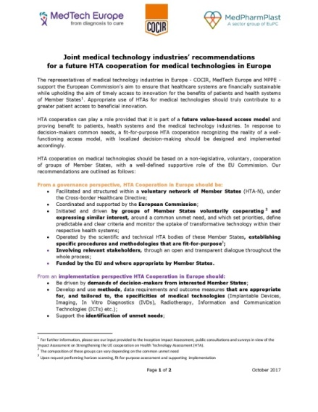
Our asks
1. HTA cooperation should be:
  based on voluntary cooperation of groups of Member States
  for technologies selected on the basis of their value (transformative technologies)
  with processes and methodologies that are appropriate and tailored to the specificities of medical technologies.
2. The links with the IVDR/MDR should be untangled.
Detailed description in:
“MedTech Europe Position on Future EU Cooperation on Health Technology Assessment”
Joint medical technologies industries’ recommendations

Slide 21
External timeline
Before EP elections in 2019? The European Parliament and the Council might agree on a position
3 years application period (2020-2023?): Commission will adopt specific rules in secondary legislation
3 years transition period (2023-2026): Member States CAN participate in joint clinical assessments and joint scientific consultations
Now: the file picked up by the European Parliament and assigned to a rapporteur (Ruiz MEP, S&D, ES) and shadow Rapporteurs

Slide 22
Thank you!
Chris Breyel
Director, MD Members Relations & MedTech Europe Events

